Slide 1
Hiring Process Analytics
BY AMRUTH

Slide 2
Project Description
Hiring process is the fundamental and the most important function of a company.
Here, the MNCs get to know about the major underlying trends about the hiring process.
Trends such as- number of rejections, number of interviews, types of jobs, vacancies etc.
are important for a company to analyse before hiring freshers or any other individual.
Thus, making an opportunity for a Data Analyst job here too!

Slide 3
Approach
Step 1 : Imported the dataset to my Excel sheet
Step 2 : Understood the data and relationship among the columns
Step 3 : Debugging the Questions Asked by Hiring Team
Step 4 : Analysis made using excel formulas and created pivots for visualisation
Step 5 : Visualisaton on the analysed data to derive more insights

Slide 4
Tech-Stack Used
Microsoft Excel -For complete project
ANALYSIS
|
|
VISUALIZATION
canva-To make ppt

Slide 5
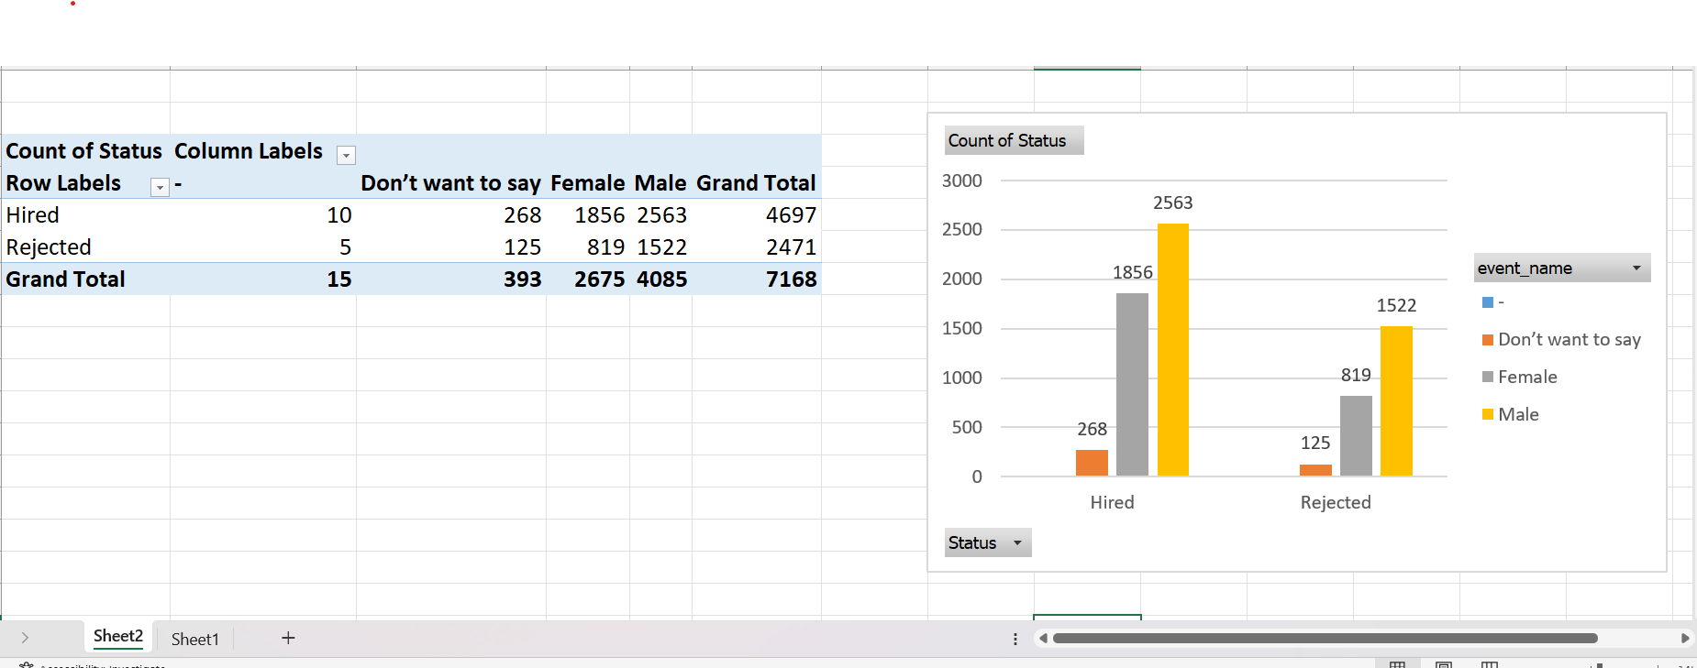
How many males and females are Hired ?

Slide 6
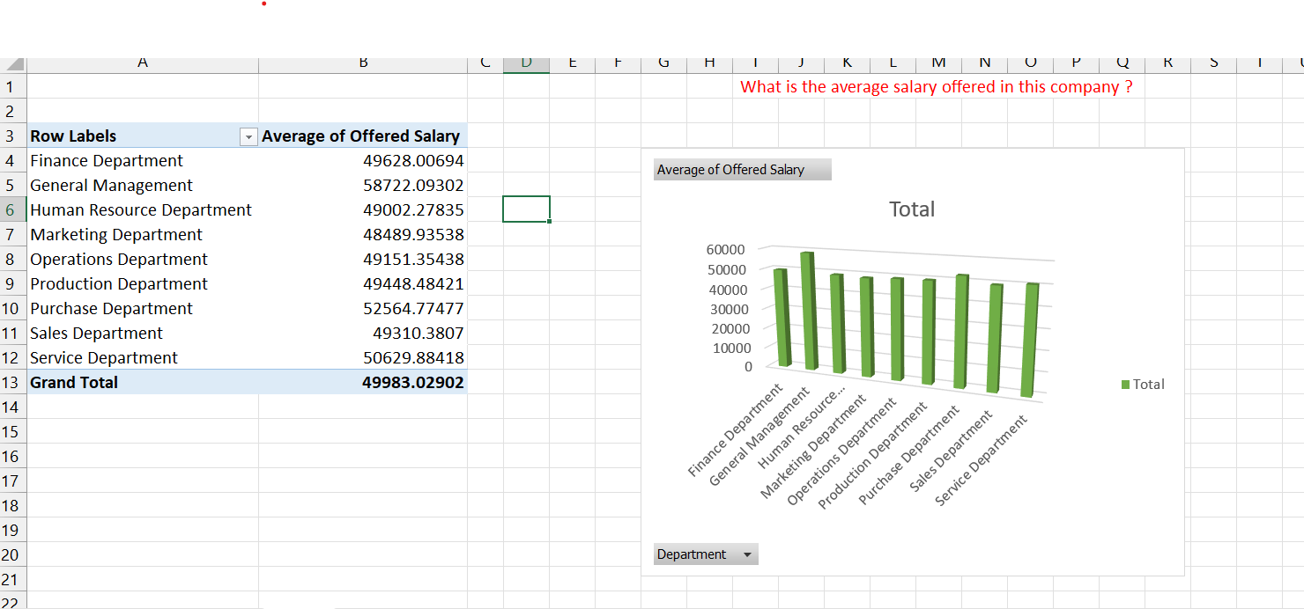
What is the average salary offered in this company ?

Slide 7
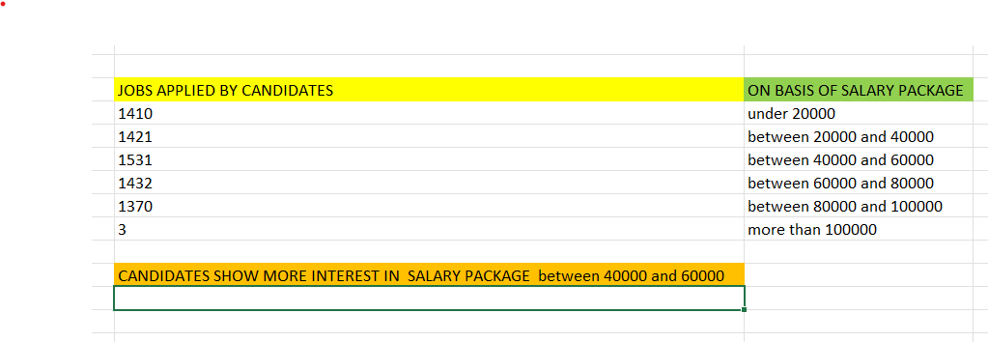
Draw the class intervals for salary in the company ?

Slide 8
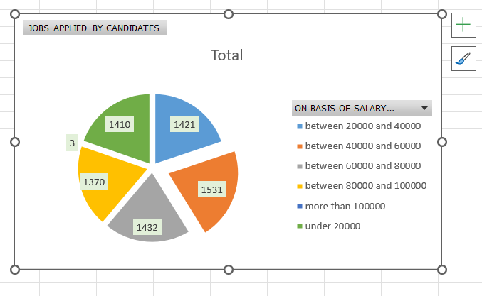

Slide 9
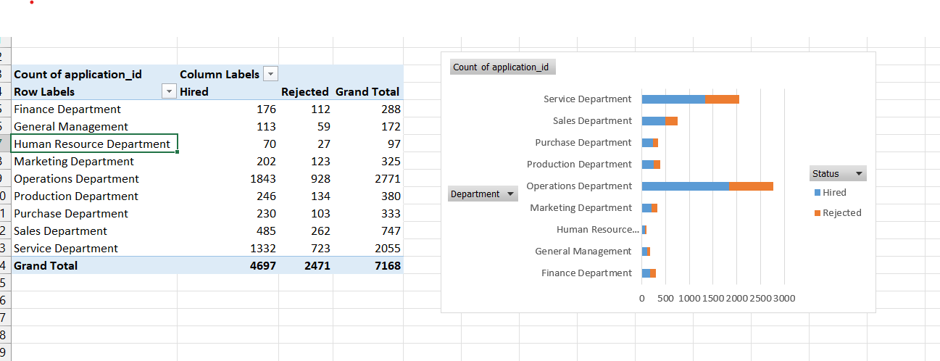
Draw Pie Chart / Bar Graph ( or any other graph ) to show proportion of people working different department ?

Slide 10
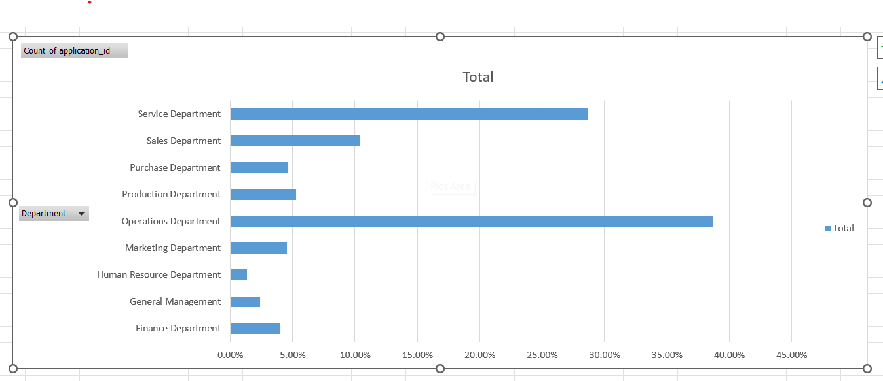

Slide 11
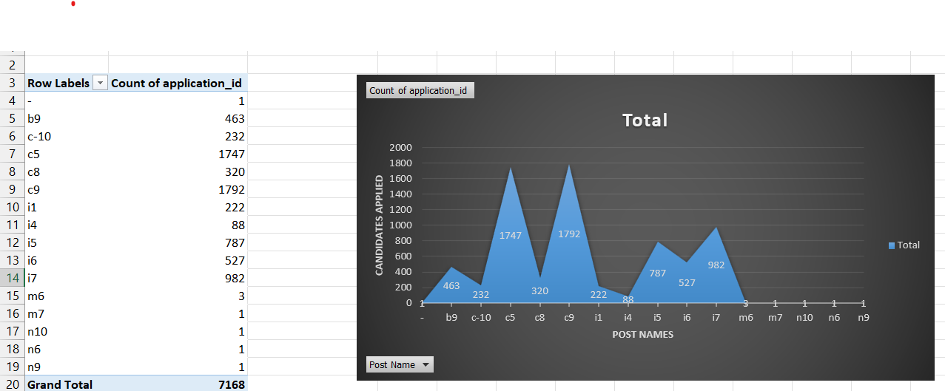
Represent different post tiers using chart/graph?

Slide 12
Insights
When hiring there are questions that arises many confusion as to calculate number of rejections, number of interviews, types of jobs, vacancies etc
During this Project I am able to provided clarity for such confusion and give more meaningful information
With the help of my Analysis skill I was able to fill the gap between hiring team of MNC and candidates looking for job roles
And overall Visualization helped to understand better about the analyzed data
We can improve further by asking questions like which time of the year hiring process happens most? etc...

Slide 13
Result
I was able to provide a solution for candidates who are looking for job so that now they can easily find which jobs have more package and what their peers are looking for? and also which sector is booming right now
So this also helped me to give some extra information to hiring team about candidates and thier progress
I understood the importance how to use tool like Ms-Excel to reduce problems in such real world scenarios

Slide 14
Drive Link
CLICK HERE to view my analysis and visualization

Slide 15
THANK YOU

